Slide 1
Discussion 3: {O, b, j, e, c, t, s}
Christine Zhou

Slide 2
Agenda
Announcements
Review: Box and Pointers
Worksheet #1
Review: OOP and Static vs Non-Static
Worksheet #2
Review: Arrays
Worksheet #3
(Extra: Worksheet #4)

Slide 3
Announcements
Project 0: Galaxies is due 9/17, next Monday!
Lab this week will partially be about the project and will include an IntelliJ demo.
HW1 is due today at 11:59 PM
HW2 will be released this week, will be due around 9/21
Midterm 1 Conflict Form will be posted on Piazza tonight
Due this Friday 9/14
MT1 is Thursday, Sept 27 7-9PM
Discussion survey: https://tinyurl.com/cz-disc3-fa18

Slide 4
Review: Box and Pointer Diagrams
Two kinds of variables
Primitive
int, double, boolean, float, byte, char, long, short
Reference
Everything else!
How do we represent each of these in box and pointer diagrams?

Slide 5
Review: Box and Pointer Diagrams
Box and Pointers are the 61B equivalent of 61A’s environment diagram
They are crucial to helping us keep track of what goes on in a program: use them!
Java is pass-by-value! If you have y = x, copy whatever is in x’s box into y’s box
We didn’t specify what integers are going in the array, so Java initializes it with the default value 0
int x = 29;
int[] arr = new int[3];
Int x
int[ ] arr
29
0
0
0
Primitives go in the box
Reference types are referenced via pointers

Slide 6
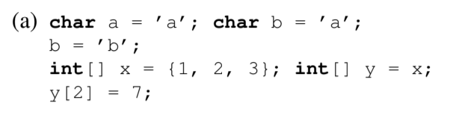
1 Boxes and Pointers II

Slide 7
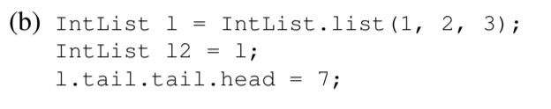
1 Boxes and Pointers II

Slide 8
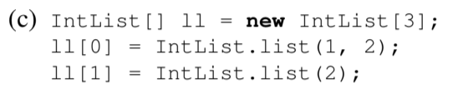
1 Boxes and Pointers II

Slide 9
Review: Object Oriented Programming
Class: define characteristics and behaviors of our object, act as a blueprint/template for our objects
Can create instances of the object by using the constructor and the new keyword
Human h = new Human(“Bob”, 1)
“this” refers to the object that you are creating, like “self” in Python!
public class Human {
String name; int age; static int population;
public Human(String name, int age) {
this.name = name;
this.age = age;
population += 1;
}
public void greet() {
System.out.println(“Hi! I’m ” + this.name)
}
public static void getPopulation() {
System.out.println(population);
}
}

Slide 10
Review: Object Oriented Programming
Non-static (instance) variables and methods:
Belong to the object itself
Each person has their own name, age, and way to greet people
Static (class) variables and methods:
What is one static method that you’ve seen already?
Belong to the class, no notion of “this”
Preceded with “static”
The “population” variable belongs to all Humans, not just one Human!
public class Human {
String name; int age; static int population;
public Human(String name, int age) {
this.name = name;
this.age = age;
population += 1;
}
public void greet() {
System.out.println(“Hi! I’m ” + this.name)
}
public static void getPopulation() {
System.out.println(population);
}
}

Slide 11
Review: Object Oriented Programming Examples
// In the Human class
// Let’s say we called this method like
// bob.testNonStatic(apple)
public void testNonStatic(Human you) {
greet();
this.greet();
you.greet();
Human.greet();
getPopulation();
this.getPopulation();
you.getPopulation();
Human.getPopulation();
}
public class Human {
String name; int age; static int population;
public Human(String name, int age) {
this.name = name;
this.age = age;
population += 1;
}
public void greet() {
System.out.println(“Hi! I’m ” + this.name)
}
public static void getPopulation() {
System.out.println(population);
}
}

Slide 12
Review: Object Oriented Programming Examples
// In the Human class
// Let’s say we called this method like
// bob.testNonStatic(apple)
public void testNonStatic(Human you) {
greet();
this.greet();
you.greet();
Human.greet(); // compile-time error!
getPopulation();
this.getPopulation();
you.getPopulation();
Human.getPopulation();
}
public class Human {
String name; int age; static int population;
public Human(String name, int age) {
this.name = name;
this.age = age;
population += 1;
}
public void greet() {
System.out.println(“Hi! I’m ” + this.name)
}
public static void getPopulation() {
System.out.println(population);
}
}
Notes:
Greet: works, same as this.greet, the this is implicit!
This.greet: works, greet is an instance method from within the Human class so it must be called with an instance, the instance in this case is “this”
You.greet: works, greet is an instance method from the Human class and needs to be called on an instance (in this case “you”)
Human.greet(): doesn’t work, there is no instance to act on, Human is not an instance so you cannot call an instance method on a class
getPopulation(): works, same as this.getPopulation(), the this is implicit
this.getPopulation(): works, essentially calling getPopulation on an instance (this), can call static methods on the instance because they are part of the class
you.getPopulation(): works, calling getPopulation on an instance (you), and can call static methods on an instance
Human.getPopulation(): works, can call static methods on the class because static methods belong to the class, no reference to instance variables so no need to call with an instance

Slide 13
Review: Object Oriented Programming Examples
// In the Human class
// Let’s say we called this method like
// bob.testStatic(apple)
public static void testStatic(Human you) {
greet();
this.greet();
you.greet();
Human.greet();
getPopulation();
this.getPopulation();
you.getPopulation();
Human.getPopulation();
}
public class Human {
String name; int age; static int population;
public Human(String name, int age) {
this.name = name;
this.age = age;
population += 1;
}
public void greet() {
System.out.println(“Hi! I’m ” + this.name)
}
public static void getPopulation() {
System.out.println(population);
}
}

Slide 14
Review: Object Oriented Programming Examples
// In the Human class
// Let’s say we called this method like
// bob.testStatic(apple)
public static void testStatic(Human you) {
greet(); // compile-time error!
this.greet(); // compile-time error!
you.greet();
Human.greet(); // compile-time error!
getPopulation();
this.getPopulation(); // compile-time error!
you.getPopulation();
Human.getPopulation();
}
public class Human {
String name; int age; static int population;
public Human(String name, int age) {
this.name = name;
this.age = age;
population += 1;
}
public void greet() {
System.out.println(“Hi! I’m ” + this.name)
}
public static void getPopulation() {
System.out.println(population);
}
}
Notes:
greet(): doesn’t work, cannot call an instance method without calling it on an instance, usually the “this” is implicit but there’s no notion of “this” in a static method (it belongs to a class so there’s no instance)
this.greet(): doesn’t work, no notion of “this” in a static method
you.greet(): works, calling an instance method on an instance, works even though we are in a static function. As long as we have an instance to call it on, an instance method won’t cause any problems
Human.greet(): doesn’t work, calling an instance method on a class, need to have an instance to act on
getPopulation(): works, it’s a static method, no need to call it on an object so it will work
this.getPopulation(): doesn’t work, no notion of this in a static method
you.getPopulation(): works, we are calling it on an instance that is passed in, can still call static methods on instances because they are part of the class
Human.getPopulation(): works, can call a static method on a class

Slide 15
Review: Object Oriented Programming Examples
public class HumanRunner {
public static void main(String[] args) {
Human chris = new Human(“Chris”, 5);
greet();
chris.greet();
chris.getPopulation();
Human.getPopulation();
}
}
public class Human {
String name; int age; static int population;
public Human(String name, int age) {
this.name = name;
this.age = age;
population += 1;
}
public void greet() {
System.out.println(“Hi! I’m ” + this.name)
}
public static void getPopulation() {
System.out.println(population);
}
}

Slide 16
Review: Object Oriented Programming Examples
public class HumanRunner {
public static void main(String[] args) {
Human chris = new Human(“Chris”, 5);
greet(); // compile-time error!
chris.greet();
chris.getPopulation(); // OK, but bad practice
Human.getPopulation();
}
}
public class Human {
String name; int age; static int population;
public Human(String name, int age) {
this.name = name;
this.age = age;
population += 1;
}
public void greet() {
System.out.println(“Hi! I’m ” + this.name)
}
public static void getPopulation() {
System.out.println(population);
}
}
Notes:
greet(): doesn’t work because there is no instance to call it on. We are calling greet from a static method so there is no notion of this
chris.greet(): works because we are calling it on an instance
chris.getPopulation(): works, even though this method belongs to the class, the instance is a part of the class so it can still access it
Human.getPopulation(): works, a static method belongs to the class, so a class can call a static method

Slide 17
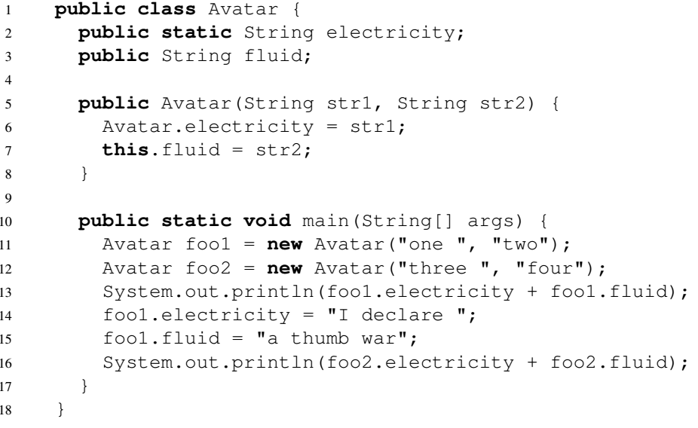
2 Objects Refresher
(a) Determine what would be printed after executing the main method of class Avatar.
Draw something to keep track of all the objects and variables!

Slide 18
2 Objects Refresher
(b) If we made electricity an instance variable and fluid a class variable instead, would this code still compile? If not, identify what would cause the error.
Static means it’s for the class, non-static means it’s for the instance!

Slide 19
2 Objects Refresher
(c) Reverting our changes from part (b) and starting from the original code, will adding the following method to class Avatar cause any errors during compilation or execution?
public static String getFluid() {
return fluid;
}
Think about static vs non-static!

Slide 20
Review: Arrays
Can instantiate in many ways
int[] values = new int[7];
int[] oneThroughFive = new int[]{1, 2, 3, 4, 5};
int[] oneThroughFive = {1, 2, 3, 4, 5}; // works but only if you declare and instantiate in same line
Cannot resize bigger/smaller once you create it!
Access elements by indexing, which start at 0
oneThroughFive[2] = 3
Constant time accesses wherever you are in the array
This will become more important later on when we compare data structures against each other

Slide 21
3 Min/Max
Given an array A, return a 2 element array B where B[0] is the minimum element of A and B[1]
is the maximum element of A.
import static java.lang.Math.max; // max(a, b) returns max of a, b
import static java.lang.Math.min; // min(a, b) returns min of a, b
public static int[] minMax(int[] A) {
int maxVal = Integer.MIN_VALUE; // smallest int in Java
int minVal = Integer.MAX_VALUE; // largest int in Java

Slide 22
4 Reverse
Given an array A, reverse its elements in place (i.e. do not create any new arrays; this should be a destructive method).
public static void reverse(int[] A) {

